Slide 1
A Survey on the Applications of Graph Neural Networks in Recommender Systems
Qian Long, Yujun Zhao, Ruochen Wang

Slide 2
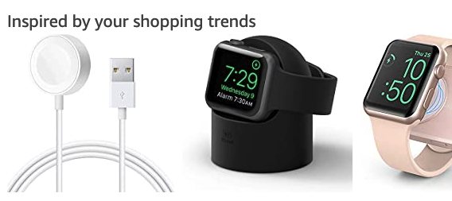
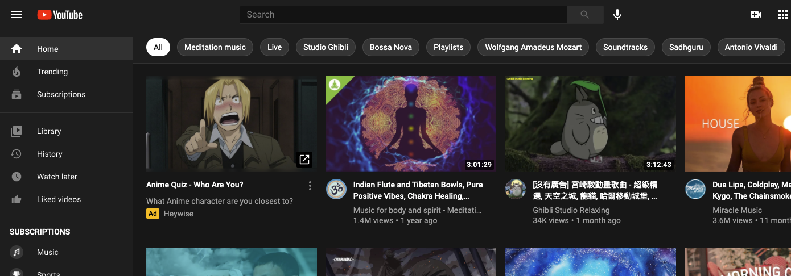
Introduction
Recommender Systems in action:
Shopping on Amazon
Youtube
Tiktok
Uber Eats
Many more

Slide 3
Introduction
Importance
Search vs Recommendation
Information distribution in PC Era: Search
Main devices: pc and laptops
Hard to collect user data
Information distribution in Mobile Internet Era: Recommendation
Main device: smartphones
Carried around with users all the time
Easy to collect user data

Slide 4
Recommender systems (RS)
General RS
assume static user preferences (i.e. time-invariant)
user-item interaction as matrix (adj)
recommendation as matrix completion task
user latent vec, item latent vec -> interaction matrix
Matrix Factorization, Collaborative Filtering
Sequential RS
next-item recommendation
capture item to item transition information
recommendation as time-series prediction
MC, RNN, Transformers

Slide 5
Recommender systems (RS)
Formulation:
Given:
Main info:
user (attributes)
item (attributes)
user feedback on items (user-item interactions)
Side info: (to solve data sparsity and cold start issue)
social relationship between users
knowledge graph
Infer:
users’ preferences
item properties

Slide 6
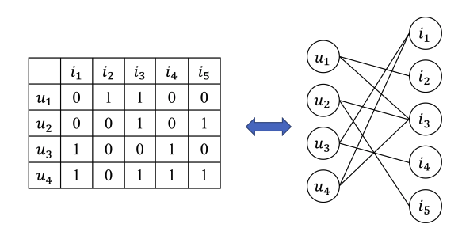
GNN + RS
RS data are graphs in natural
user-item interaction matrix: adj matrix
GNN triumphs in representation learning for graphs
RS benefits from side information, which are also mostly graph data.
Social networks
Knowledge graphs

Slide 7





GNN (brief)
Some of the most widely adopted GNNs in RS:
GCN
GraphSage
GAT
D
GGNN (gated recurrent units as nonlinearity)

Slide 8
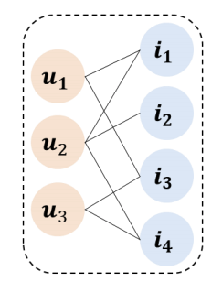
General RS - w/o side information
Overview:
Represent user-item interaction as bipartite graph
Apply GNN to this bipartite graph
Main concerns
Graph construction
Neighbor aggregation
Information Update
Final Node Representation

Slide 9
General RS - Graph Construction
RS datasets are usually large scale graphs
We need to sample nodes for message passing
Key methods:
PinSage:
sample fixed-size neighbors by random-walk
IG-MC:
sample subgraphs
better generalization to new graphs (intuitively)

Slide 10
General RS - Neighbor aggregation
Main categories of aggregation function
Differentiating the influence of neighbors
attentive pooling (attention)
central node augmentation (use central node to filter neighbors’ message)
Treat all neighbors equally
mean pooling
degree normalization
(a) works better in general, since interacted items are not equally representative to reflect user preferences.

Slide 11
General RS - other two concerns
Main concerns
Graph construction
Neighbor aggregation
Information Update
pooling
concatenation
Final Node Representation
use last-layer embedding as user/item representation
use all-layer embeddings as user/item representation
output from different layers express different connections

Slide 12
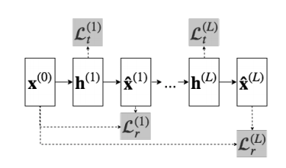
General RS w/o side info - representative methods
STAR-GCN (STAcked and Reconstructed GCN)
Prevent oversmoothing of GCN with too many layers
Stack multiple gcn blocks rather than adding layers
Training leakage issue of GNN on RS:
The rating value, which we want to predict, are included in the graph data, and will go into the embeddings
sample-and-remove (masking)

Slide 13
General RS w/o side info - representative methods
PinSage
Use random walk to sample a fixed size of neighbors.
Start from a specific node e
compute normalized visit counts of random walk trajectory
Top-T visited nodes -> neighbors of e
Use neighbor importance pooling
last-layer embedding as the representation
Scalable to web-scale recommendation tasks with millions of users and items

Slide 14
Recommender Systems With Social Network
Introduction
Potential to help get better user embedding by using social network
Social Network is a homogeneous graph
Social influence recursively propagate -- my friend’s friend may also have something in common with me

Slide 15
Recommender Systems With Social Network
Difficulty: How to use Social Network to enhance the prediction?
Influence of friends: Do friends have equal influence? How to measure it?
Preference Integration: How to integrate the user representations from social influence perspective and interaction behavior?

Slide 16
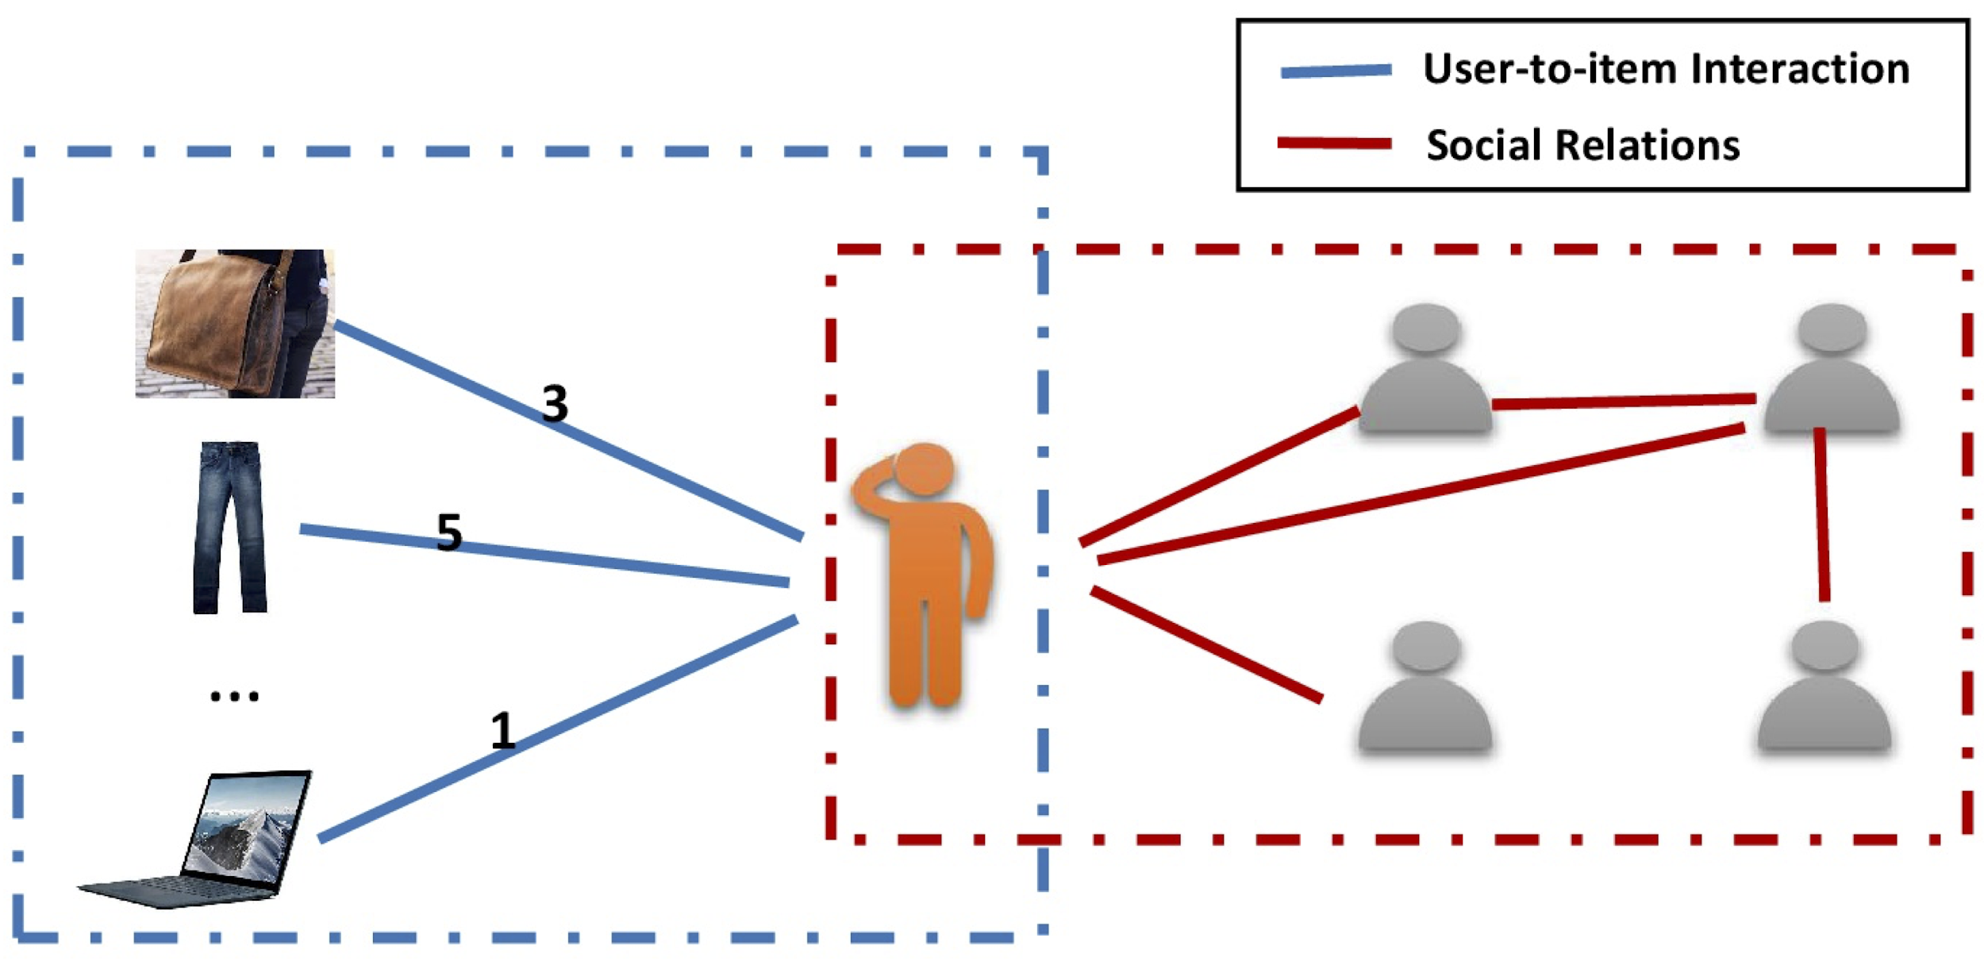
Recommender Systems With Social Network
Ref:https://github.com/wenqifan03/GraphRec-WWW19

Slide 17
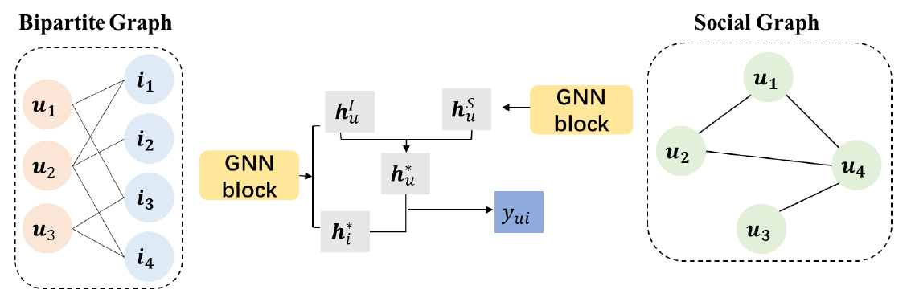
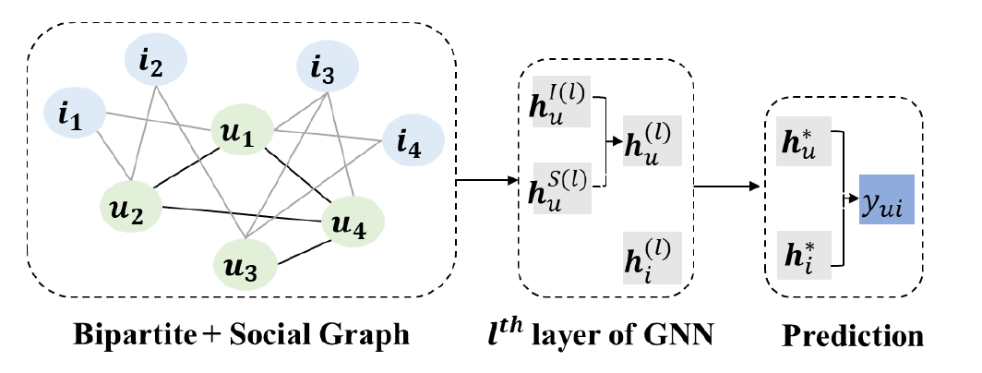
Recommender Systems With Social Network
Preference Integration: How to integrate the user representations from social influence perspective and interaction behavior?

Slide 18
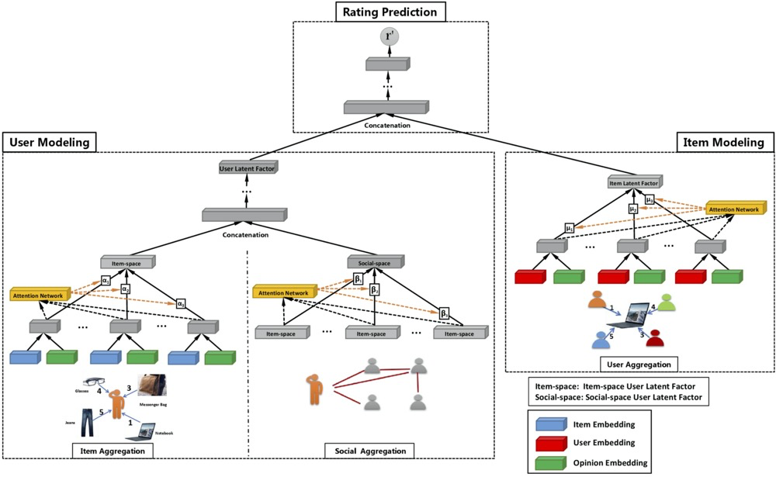
Representative Method: GraphRec
GraphRec:
Train on separate graph
Concatenate User embedding

Slide 19
Recommender Systems With Social Network
Conclusion
Influence Modeling:
Most works utilize attention to differentiate the influence of friends
Will the influence of friends vary with items? Some work also explore this possibility.
Preference Integration:
Some work learn the user representation from two networks respectively
Advantage: Both graph are homogeneous
Some work combine them into one.
Advantage: Update user representation simultaneously by two kinds of information

Slide 20
Recommender Systems With Knowledge Graph
Introduction
Rich semantic relatedness among items in KG
Improve the accuracy of prediction result
Can reasonable extend a user’s interest

Slide 21
Recommender Systems With Knowledge Graph
Difficulty: How to use KG to enhance the prediction?
Integration: Treat two graphs separately or merge them?
Graph Simplification: Do we make all efforts on the KG, or on its sub-graph?
Multi-relation Propagation: There are different relationship. Should we give them the same weight for a certain user?

Slide 22
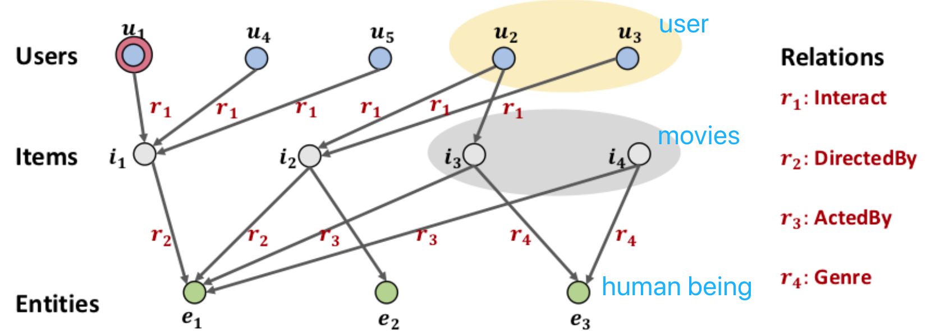
RS With KG: Representative Method
KGAT:
Combine two graphs into one
Use attention mechanism by (entity1, relation, entity2)

Slide 23
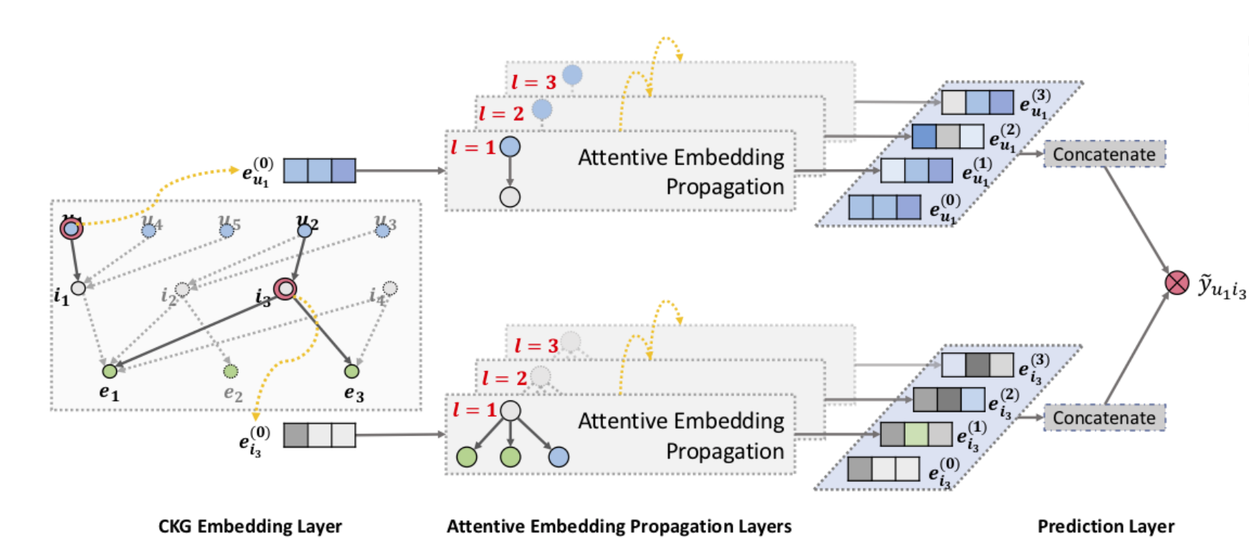
RS With KG: Representative Method
KGAT:
For each item and user node, use attention to gather their neibor’s information
Concatenate embeddings from different jump (l=1, l=2, l=3… l=L)

Slide 24

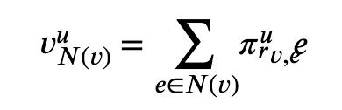
RS With KG: Representative Method
KGCN
Get only item embedding from the KG, assume user embedding is static
Sample only a fixed size of neighbors to simplify the network
Different user attaches different importance to different relations

Slide 25
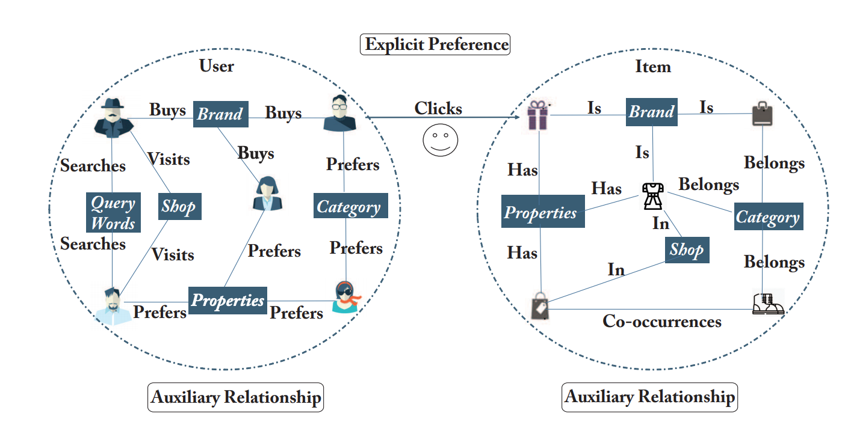
RS With KG: Representative Method
IntentGC
Create subgraph: user-user / item-item
Learn user embedding and item embedding from the subgraph

Slide 26
Recommender Systems With Knowledge Graph
Conclusion
Integration:
Some methods adopt GNN to learn the representation of items
Some methods integrate the two graphs into a unified one and learn the embedding of both users and items

Slide 27
Recommender Systems With Knowledge Graph
Conclusion
Graph Simplification：
Some methods reconstruct the subgraph based on the shortest path algorithm
Some methods only keeps the user-to-user relationship and item-to-item relationship that only one node apart.
Multi-relation Propagation:
Some methods emphasize on user-relation part -- the importance of one relation to a certain user
Some methods consider both the connected nodes and their relation

Slide 28
Sequential recommendation
Predict users’ next preferences based on their most recent activities
Conventional methods: RNN, LSTM, GRU
GNN can capture complex transactions

Slide 29
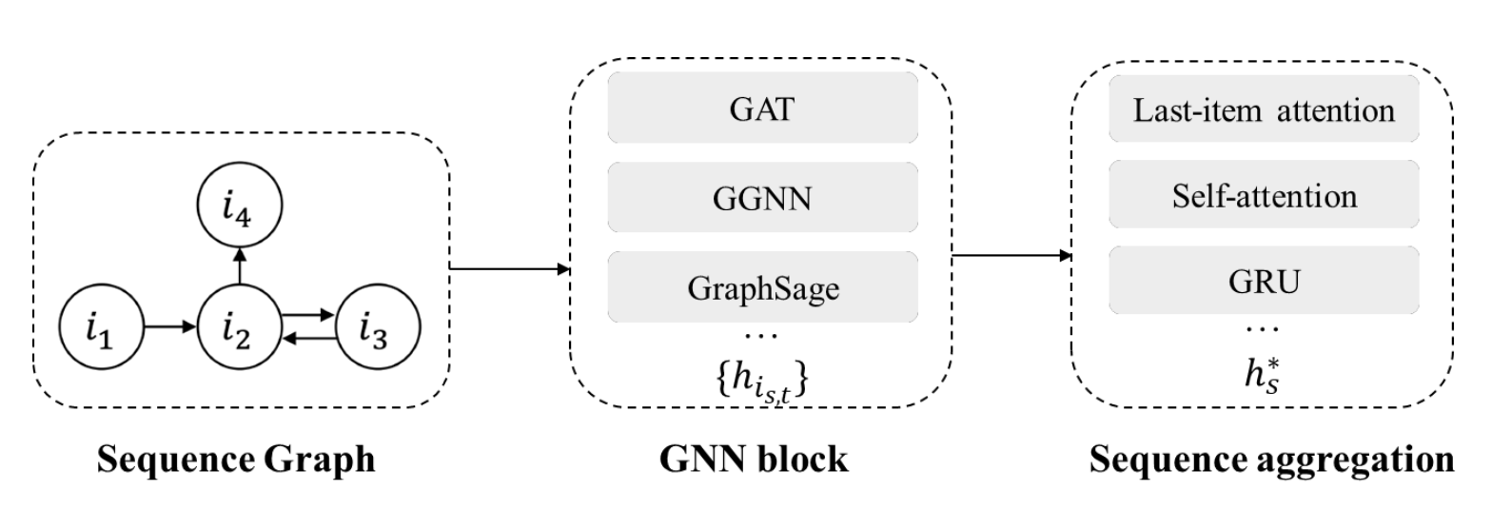
Overall structure
Graph construction
Information propagation
Sequential preference

Slide 30
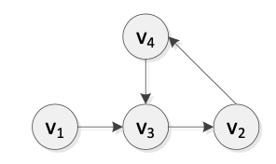
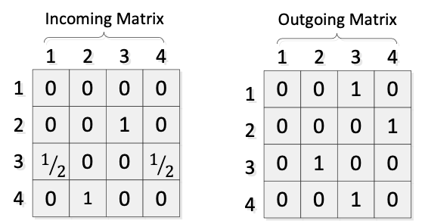
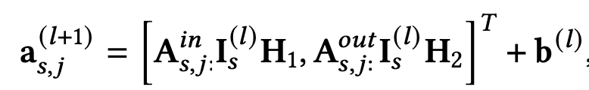
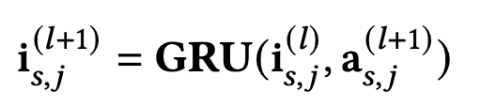
SR-GNN
S = {s1, s3, s2, s4, s3}
directed session graph for each session sequence
two adjacent matrices that represent the weighted connections of outgoing A𝑜𝑢𝑡 and incoming A𝑖𝑛 edges in the session graph respectively
During the propagation process, the item embeddings are mapped into outgoing representations and incoming representations by H1, H2 separately.
Current item propagation:
Current item update:
Item embeddings of the session 𝑠 at the 𝑙𝑡h layer

Slide 31
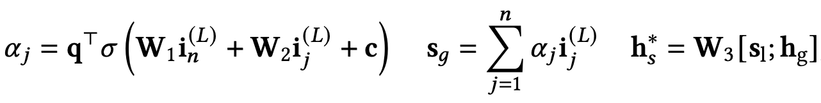
Session embedding
Global embedding
Local embedding
Control the weights of item embedding vectors
Compress two combined embedding vectors

Slide 32
GC-SAN (Graph Contextualized Self-Attention Network)
self-attention mechanism to generate the session representation
l2 normalization on both the item and session embeddings
positional embeddings are added to the item embeddings

Slide 33
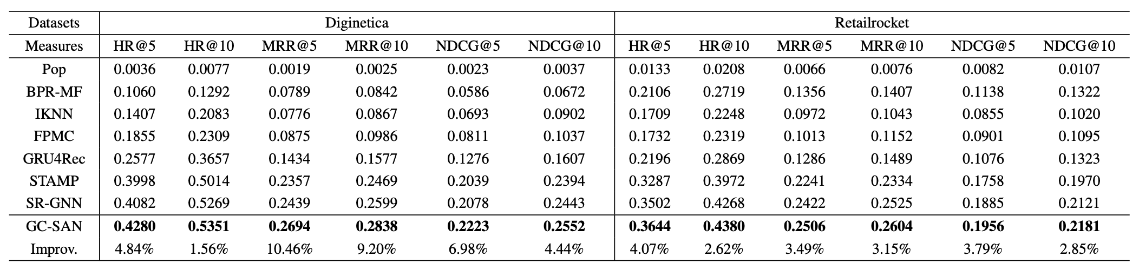
Evaluation

Slide 34
Conclusion
We provide a comprehensive review of the most recent works on GNN-based recommender systems.

Slide 35
Thanks

